Slide 1
Lecture 6
Deadlock

Slide 2
Deadlock and Starvation
Let S and Q be two semaphores initialized to 1
P₀ P₁
wait (S); wait (Q);
wait (Q); wait (S);
. .
. .
. .
signal (S); signal (Q);
signal (Q); signal (S);

Slide 3
Deadlock and Starvation
Deadlock – two or more processes are waiting indefinitely for an event that can be caused by only one of the waiting processes
Starvation – indefinite blocking. A process may never be removed from the semaphore queue in which it is suspended …. If LIFO

Slide 4
Deadlocks

Slide 5
The Deadlock Problem
A process must request a resource before using it and must release the resource after using it.
A process may request as many resources as it requires to carry out its designated task.
The number of resources requested may not exceed the total number of resources available in the system.
A set of blocked processes each holding a resource (memory space, CPU, files, printer or I/O devices) and waiting to acquire a resource held by another process in the set.

Slide 6
The Deadlock Problem
Under the normal mode of operation, a process may utilize a resource in only the following sequence:
Request. The process requests the resource. If the request cannot be granted immediately (for example, if the resource is being used by another process), then the requesting process must wait until it can acquire the resource.
Use: The process can operate on the resource (for example, if the resource is a printer, the process can print on the printer).
Release: The process releases the resource.

Slide 7
The Deadlock Problem
A set of processes is in a deadlocked state when every process in the set is waiting for an event (resource acquisition) that can be caused only by another process in the set.
Example
  System has 2 disk drives
  P₁ and P₂ each hold one disk drive and each needs another one.
  semaphores A and B, initialized to 1
  P0 P1
  wait (A); wait(B)
  wait (B); wait(A)

Slide 8
Bridge Crossing Example
Traffic only in one direction
Each section of a bridge can be viewed as a resource
If a deadlock occurs, it can be resolved if one car backs up (preempt resources and rollback)
Several cars may have to be backed up if a deadlock occurs
Starvation is possible
Note – Most OSes do not prevent nor deal with deadlocks

Slide 9
System Model
Resource types R₁, R₂, . . ., R_{m}
    CPU cycles, memory space, I/O devices
Each resource type R_{i} has W_{i} instances.
Each process utilizes a resource as follows:
  request
  use
  release

Slide 10
Deadlock Characterization
Deadlock can arise if four conditions hold simultaneously.
Mutual exclusion: only one process at a time can use a resource.
Hold and wait: a process holding at least one resource is waiting to acquire additional resources held by other processes.
No preemption: a resource can be released only voluntarily by the process holding it, after that process has completed its task.
Circular wait: there exists a set {P₀, P₁, …, P₀} of waiting processes such that P₀ is waiting for a resource that is held by P₁, P₁ is waiting for a resource that is held by
P₂, …, P_{n–1} is waiting for a resource that is held by
P_{n}, and P₀ is waiting for a resource that is held by P₀.

Slide 11
Resource-Allocation Graph
Deadlocks can be described more precisely in terms of a directed graph called a system resource –allocation graph.
This graph consists of a set of vertices V and a set of edges E. The set of vertices V is partitioned into two different types of nodes: P = { P1,P2, ... , Pn}, the set consisting of all the active processes in the system, and R = {R1,R2,... , Rm}, the set consisting of all resource types in the system.

Slide 12
Resource-Allocation Graph (Cont.)
Process
Resource Type with 4 instances
P_{i} requests instance of R_{j}
P_{i} is holding an instance of R_{j}
P_{i}
R_{j}
P_{i}
R_{j}

Slide 13
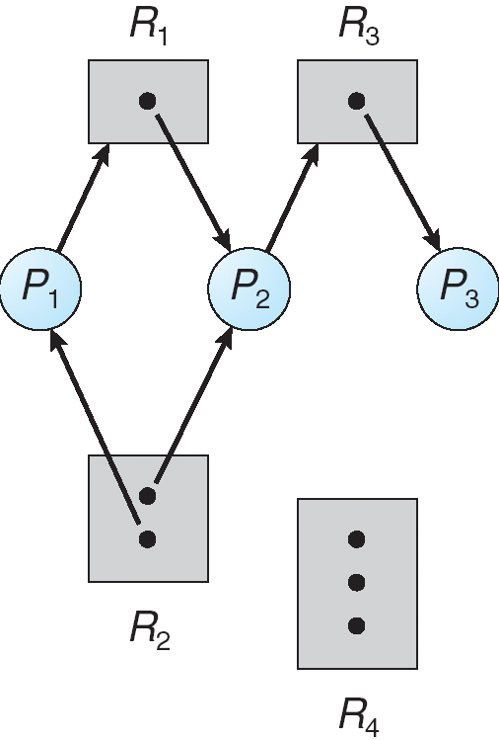
Example of a Resource Allocation Graph

Slide 14
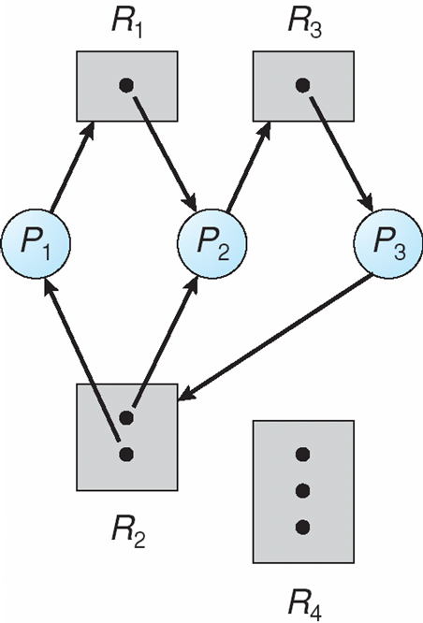
Resource Allocation Graph With A Deadlock

Slide 15
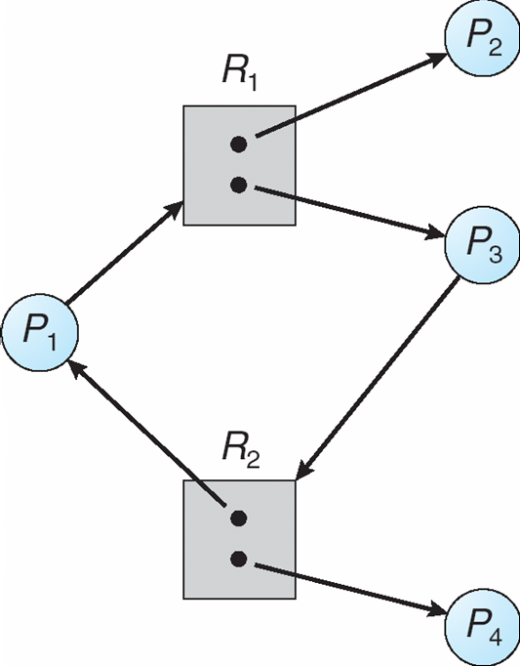
Graph With A Cycle But No Deadlock

Slide 16
Basic Facts
If graph contains no cycles ⇒ no deadlock
If graph contains a cycle ⇒
  if only one instance per resource type, then deadlock.
  if several instances per resource type, possibility of deadlock.

Slide 17
Methods for Handling Deadlocks
We can use a protocol to prevent or avoid deadlocks, ensuring that the system will never enter a deadlocked state.
We can allow the system to enter a deadlocked state, detect it, and recover.
We can ignore the problem altogether and pretend that deadlocks never occur in the system.
This solution is the one used by most operating systems, including UNIX and Windows; it is then up to the application developer to write programs that handle deadlocks.

Slide 18
Deadlock Prevention
Restrain the ways request can be made
For a deadlock to occur, each of the four necessary conditions must hold.
By ensuring that at least one of these conditions cannot
hold, we can prevent the occurrence of a deadlock.
Mutual Exclusion – not required for sharable resources; must hold for nonsharable resources (printer).

Slide 19
Deadlock Prevention
Restrain the ways request can be made
Hold and Wait – must guarantee that whenever a process requests a resource, it does not hold any other resources.
  Require a process to request and be allocated all its resources before it begins execution, or allow process to request resources only when the process has none.

Slide 20
Deadlock Prevention
we consider a process that copies data from a DVD drive to a file on disk, sorts the file, and then prints the results to a printer. If all resources must be requested at the beginning of the process, then the process must initially request the DVD drive, disk file, and printer. It will hold the printer for its entire execution, even though it needs the printer only at the end.

Slide 21
Deadlock Prevention
The second method allows the process to request initially only the DVD drive and disk file. It copies from the DVD drive to the disk and then releases both the DVD drive and the disk file. The process must then again request the disk file and the printer. After copying the disk file to the printer, it releases these two resources and terminates.

Slide 22
Deadlock Prevention
The second method allows the process to request initially only the DVD drive and disk file. It copies from the DVD drive to the disk and then releases both the DVD drive and the disk file. The process must then again request the disk file and the printer. After copying the disk file to the printer, it releases these two resources and terminates.

Slide 23
Deadlock Prevention (Cont.)
No Preemption –
  If a process that is holding some resources requests another resource that cannot be immediately allocated to it, then all resources currently being held are released.
  Preempted resources are added to the list of resources for which the process is waiting.
  Process will be restarted only when it can regain its old resources, as well as the new ones that it is requesting.

Slide 24
Deadlock Prevention (Cont.)
Circular Wait – impose a total ordering of all resource types, and require that each process requests resources in an increasing order of enumeration.
For example: we let R = { R1, R2, ... , Rm} be the set of resource types. We assign to each resource type a unique integer number, which allows us to compare two resources and to determine whether one precedes another in our ordering. if the set of resource types R includes tape drives, disk drives, and printers then

Slide 25
Deadlock Prevention (Cont.)
tape drive = 1 , disk drive = 5, printer = 12.
Each process can request resources only in an increasing order of enumeration. That is, a process can initially request any number of instances of a resource type -say, Ri. After that, the process can request instances of resource type Rj if and only if F(Rj) > F(Ri). For example, a process that wants to use the tape drive and printer at the same time must first request the tape drive and then request the printer .

Slide 26
Deadlock Avoidance
For avoiding deadlocks, additional information about how resources are to be requested is required. For example, in a system with one tape drive and one printer, the system might need to know that process P will request first the tape drive and then the printer before releasing both resources, whereas process Q will request first the printer and then the tape drive.

Slide 27
Deadlock Avoidance
With this knowledge of the complete sequence of requests and releases for each process, the system can decide for each request whether or not the process should wait in order to avoid a possible future deadlock.

Slide 28
Deadlock Avoidance
Requires that the system has some additional a priori information
available
Simplest and most useful model requires that each process declare the maximum number of resources of each type that it may need
The deadlock-avoidance algorithm dynamically examines the resource-allocation state to ensure that there can never be a circular-wait condition
Resource-allocation state is defined by the number of available and allocated resources, and the maximum demands of the processes

Slide 29
Avoidance algorithms
Denitions:
A state is safe if the system can allocate resources to each process (up to its claimed maximum) and still avoid a deadlock
A state is unsafe if the system cannot prevent processes from requesting resources such that a deadlock occurs

Slide 30
Avoidance algorithms
Assumption: For every process, the maximum resource claims are know a priori.
Idea: Only grant resource requests that can not lead to a deadlock situation
Single instance of a resource type
  Use a resource-allocation graph

Slide 31
Safe State
When a process requests an available resource, system must decide if immediate allocation leaves the system in a safe state
System is in safe state if there exists a sequence <P₁, P₂, …, P_{n}> of ALL the processes is the systems such that for each P_{i}, the resources that P_{i} can still request can be satisfied by currently available resources + resources held by all the P_{j}, with j < i
That is:
  If P_{i} resource needs are not immediately available, then P_{i} can wait until all P_{j} have finished
  When P_{j} is finished, P_{i} can obtain needed resources, execute, return allocated resources, and terminate
  When P_{i} terminates, P_{i +1} can obtain its needed resources, and so on

Slide 32
Basic Facts
If a system is in safe state ⇒ no deadlocks
If a system is in unsafe state ⇒ possibility of deadlock
Avoidance ⇒ ensure that a system will never enter an unsafe state.

Slide 33
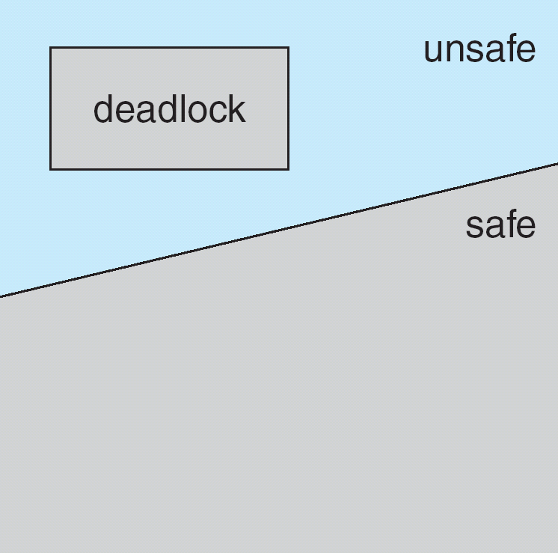
Safe, Unsafe , Deadlock State

Slide 34
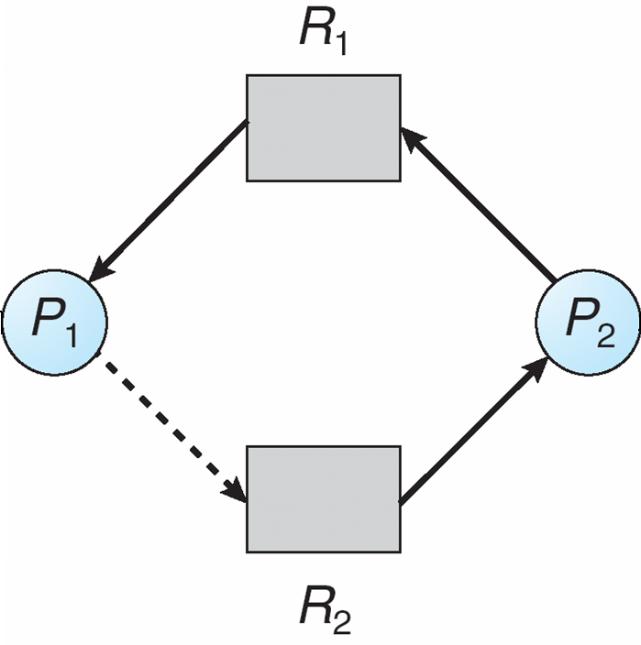
Unsafe State In Resource-Allocation Graph

Slide 35
Resource-Allocation Graph Algorithm
Suppose that process P_{i} requests a resource R_{j.}
The request can be granted only if converting the request edge to an assignment edge does not result in the formation of a cycle in the resource allocation graph.

Slide 36
Deadlock Detection
Allow system to enter deadlock state
Detection algorithm
Recovery scheme

Slide 37
Single Instance of Each Resource Type
Maintain wait-for graph
  Nodes are processes
  P_{i} → P_{j} if P_{i} is waiting for P_{j}
Periodically invoke an algorithm that searches for a cycle in the graph. If there is a cycle, there exists a deadlock
An algorithm to detect a cycle in a graph requires an order of n² operations, where n is the number of vertices in the graph

Slide 38
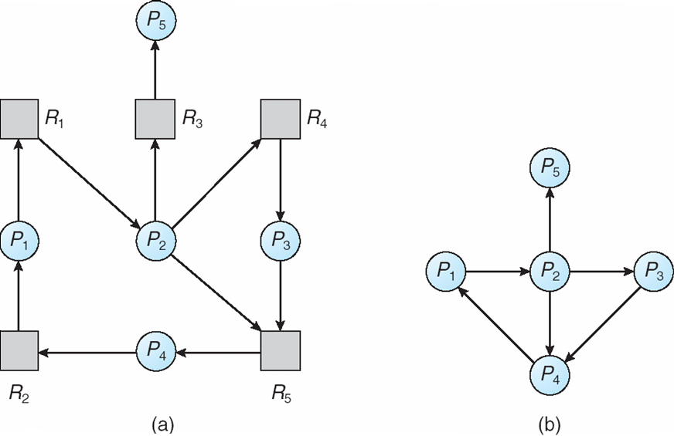
Resource-Allocation Graph and Wait-for Graph
Resource-Allocation Graph
Corresponding wait-for graph

Slide 39
Recovery from Deadlock: Process Termination
Abort all deadlocked processes
Abort one process at a time until the deadlock cycle is eliminated
In which order should we choose to abort?
  Priority of the process
  How long process has computed, and how much longer to completion
  Resources the process has used
  Resources process needs to complete
  How many processes will need to be terminated
  Is process interactive or batch?

Slide 40
Recovery from Deadlock: Process Termination
1. what the priority of the process is
2. how long the process has computed and how much longer the process will compute before completing its des

Slide 41
Recovery from Deadlock: Resource Preemption
Selecting a victim – minimize cost
Rollback – return to some safe state, restart process for that state
Starvation – same process may always be picked as victim, include number of rollback in cost factor

