Slide 1

CVS 2

Slide 2
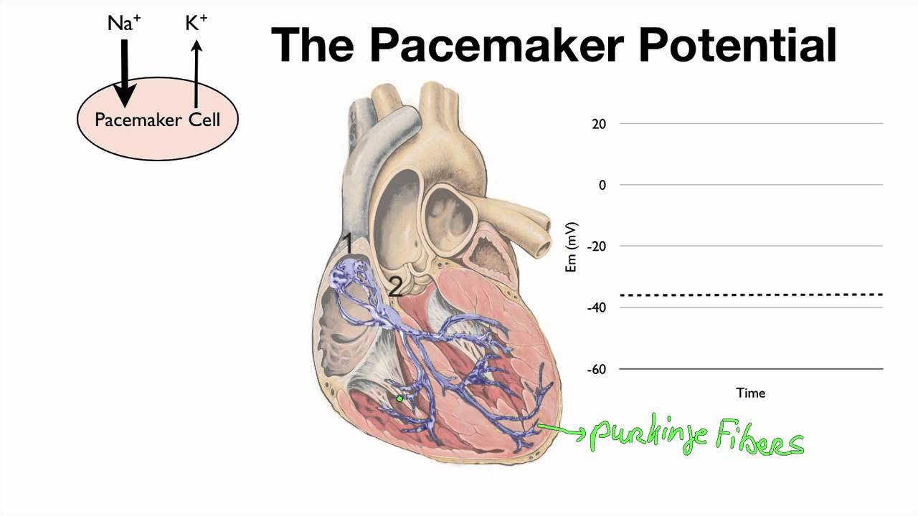

Slide 3
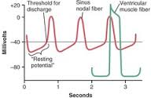

Slide 4
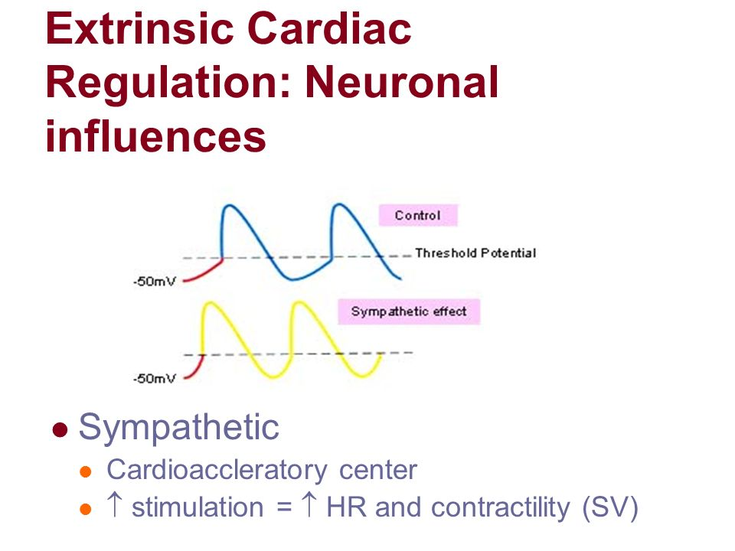

Slide 5
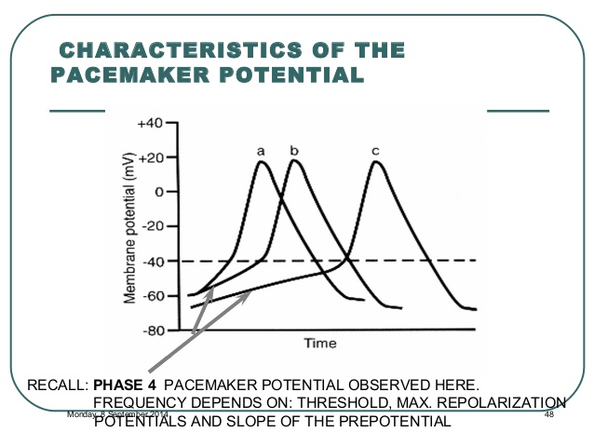

Slide 6
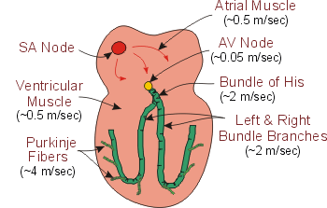

Slide 7
Cardiac contractility:
AIM
MECHANISM
FACTORS AFFECTING CONTRACTILITY:
All or non law
Tetanus
Positive and negative inotropic effect
Starling law (wisdom of the heart)

Slide 8
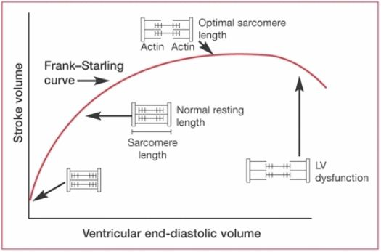

Slide 9
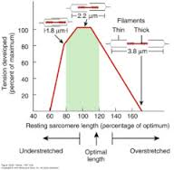

Slide 10
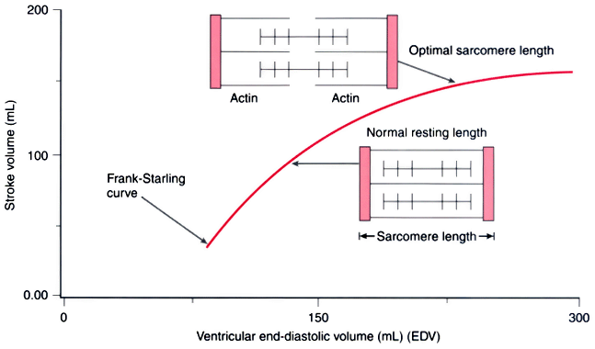

Slide 11
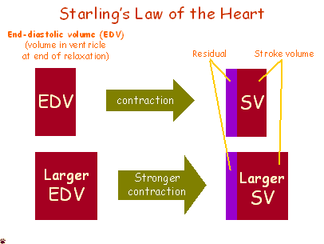

Slide 12
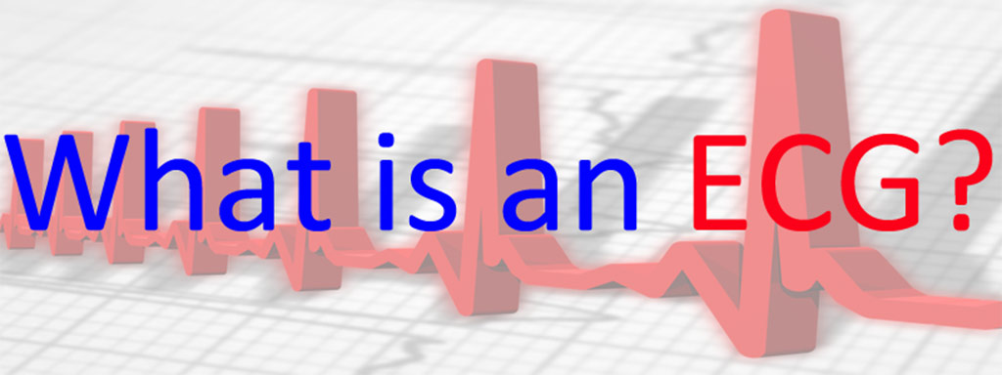
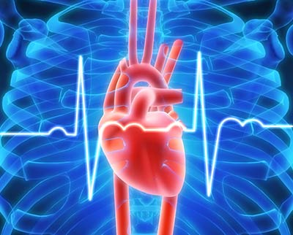

Slide 13
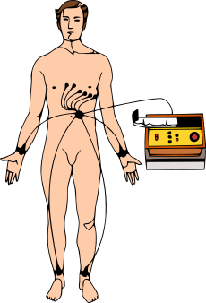
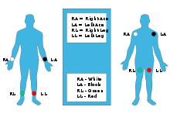
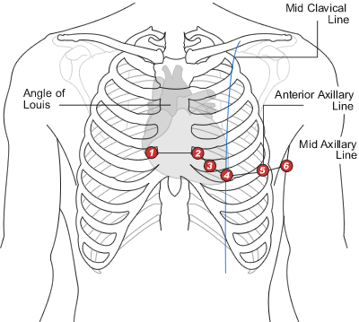

Slide 14
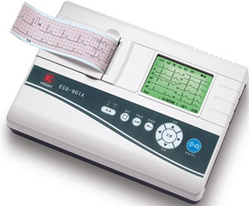
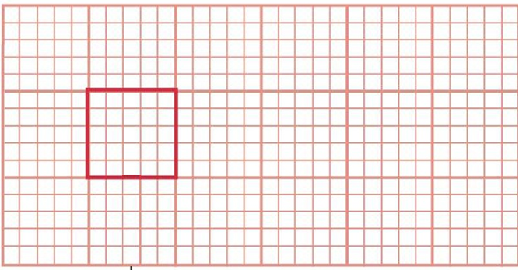
1 small square =
0.04 second duration
0.1 mV amplitude
Amplitude
1 mV
Duration
0.2 sec

Slide 15
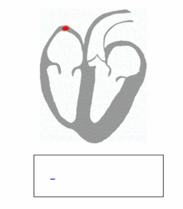

Slide 16
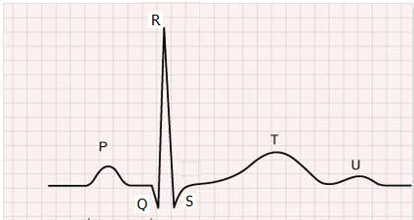
Ventricular depolarization
Duration < 0.08 sec
Amplitude~ 1.0 mV (limb leads)
~ 3.0 mV (chest leads)
Atrial depolarization
Duration < 0.1 sec
Amplitude< 0.25 mV
Ventricular repolarization
Duration ~ 0.16 sec
Amplitude~ 0.5 mV (limb leads)
~ 1.0 mV (chest leads)

Slide 17
Q-T interval
0.2-0.4 sec
P-R interval
0.12-0.2 sec

Slide 18
Useful links
Cardiac rhythmicity
https://www.youtube.com/watch?v=0xUifyll2Oc
Cardiac Conduction System and Understanding ECG, Animation
https://www.youtube.com/watch?v=RYZ4daFwMa8

