Slide 1

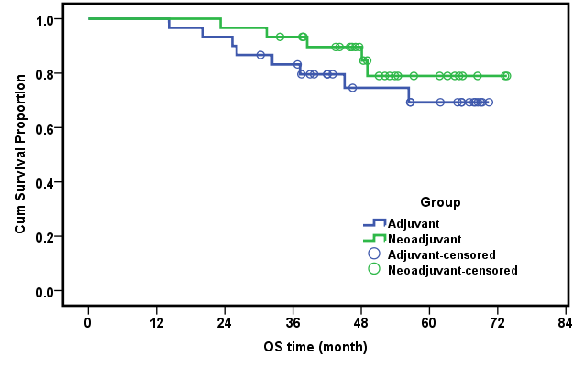
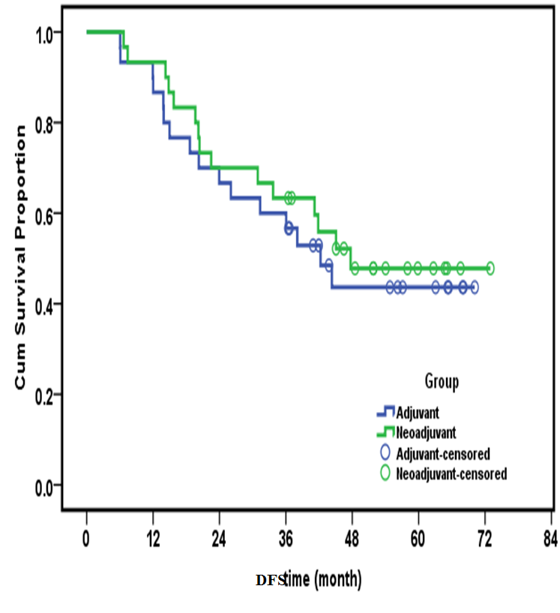
Neo-adjuvant versus adjuvant chemotherapy in advanced ovarian carcinoma
Hanan Ramadan Nassar M.D.¹, Ihab Samy Fayek M.D.¹ , Alfred Elias Namour M.D.¹
Mostafa Maher El-Gammal MSc²
¹ National Cancer Institute, Cairo University, ²Agouza police hospital , ministry of interior , Egypt
P 51
Logo
Introduction
Results
Ovarian Cancer
* Globally 7th most incident and lethal cancer
  New cases: 225,000 annually
  Deaths: 140,000 annually
  *Almost 75% of cases present with advanced stage .
*Risk of relapse of advanced stage disease is as high as 70%
Current Standard of Care
Both the American and European guidelines recommend surgery as the initial approach to ovarian malignancies . However, interval debulking surgery (IDS) has progressively become more popular.
Aim of work
This retrospective study was to assess whether there is an advantage of treating women with advanced ovarian cancer with neoadjuvant chemotherapy (NACT) compared with conventional treatment where chemotherapy follows primary cyto-reductive surgery.
Research question
In patients with advanced ovarian cancer, is neoadjuvant chemotherapy more effective than adjuvant chemotherapy?
Patients with advanced ovarian cancer should be treated by radical debulking surgery aiming at complete tumor resection. Neoadjuvant chemotherapy (NACT) has been proposed as a novel therapeutic approach in such cases.
Overall survival
The median overall survival time was 45.77 months in the conventional group and 49.06 month in the NACT group with P value (P = 0.329) fig 1.
Disease free survival
The median disease free survival was 37.35 months in the conventional group and 43.45 months in the NACT group with P value (P = 0.609) fig 2.
Figure #1 Overall survival
Figure #2 Disease free survival
CHART or PICTURE
Methods
Study Design
This is a retrospective study Include a total of 60 patients with stage III or IV epithelial ovarian carcinomas were evaluated between 2009 and 2015. All patients were submitted to debulking surgery with optimal cytoreduction R0. Neoadjuvant chemotherapy was given (in 30 patients). Conversely primary debulking surgery was performed (in 30 patients).
Patient's Characteristics
A total of 60 patients divided into 2 groups according to pattern of treatment .
Patterns of treatment
Outcome
Primary:
Overall survival calculated from date of presentation till date of death or last follow up.
Secondary:
Disease free survival calculated from date of initial treatment till date of relapse or death or last follow up
Conclusions
*Neoadjuvant chemotherapy followed by interval debulking surgery was not inferior to primary debulking surgery.
*Primary chemotherapy followed by interval debulking surgery in select group of patients doesn't appear to worsen the prognosis, but it permits a less aggressive surgery to be performed.
Bibliography
1-American Cancer Society. Cancer Facts and Figures 2015. Atlanta, GA: American Cancer Society; 2015.
2-Kehoe S, Hook J, Nankivell M, et al. (2013), Chemotherapy or upfront surgery for newly diagnosed advanced ovarian cancer: Results from the MRC CHORUS trial. J Clin Oncol 31, (suppl; abstr 5500).
3-NICE (2011). Ovarian Cancer: The recognition and initial management of ovarian cancer. Clinical Guidelines [CG122].

