Slide 1
Neuropathic Pain (NP)
By
Dr Algohary M Tantawy
Prof of Anesthesiology, ICU & Pain Management,
NCI, Cairo

Slide 2
Definition of NP
NP is defined as “pain arising as a direct consequence of a lesion or disease affecting the somatosensory system.”

Slide 3
Symptoms of N P
Continuous burning pain
Intermittent shooting, lancinating pain
Electric shock–like pain
Some paresthesias
  Abnormal sensations that are not unpleasant
Some dysesthesias
  Abnormal sensations that are unpleasant

Slide 4
Signs of NP
Hyperalgesia: An increased response to a stimulus that is normally painful
Allodynia: Pain due to a stimulus that is not normally painful

Slide 5
Underlying Mechanisms of NP
Peripheral sensitization
Ectopic discharges
Central sensitization
Central reorganization of Aβ fibers
Loss of inhibitory controls

Slide 6
Relating Symptoms or Signs to Mechanisms
Symptom or Sign
Continuous burning pain
Shooting, lancinating pain
Paresthesias or dysesthesias
Hyperalgesia
Allodynia
Possible Mechanisms
Loss of inhibitory controls,
peripheral sensitization,
ectopic discharges
Ectopic discharges
Ectopic discharges
Peripheral sensitization
Loss of inhibitory controls,
central sensitization, central
reorganization, peripheral
sensitization

Slide 7
Diagnosis: Medical History
Explore Peripheral Causes of
Neuropathic Pain
Injury from trauma/surgical procedures/pressure
Metabolic disturbances
Infections
Cancer-related
Exposure to toxins/drugs/alcohol
Vascular disease
Nutritional deficiencies
Explore Central Causes of
Neuropathic Pain
Stroke
Spinal cord lesions
Multiple sclerosis
Tumors

Slide 8
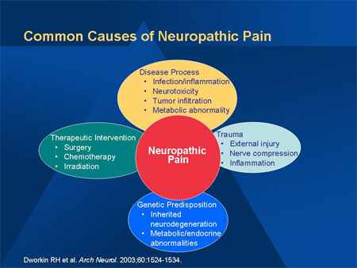

Slide 9
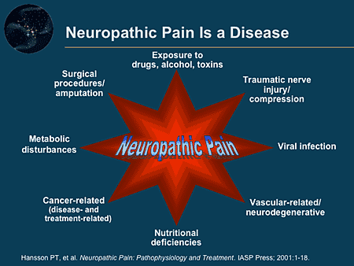

Slide 10
Diagnosis: Medical History
History of pain: quality, intensity, site, pattarn
Scales of NP

Slide 11
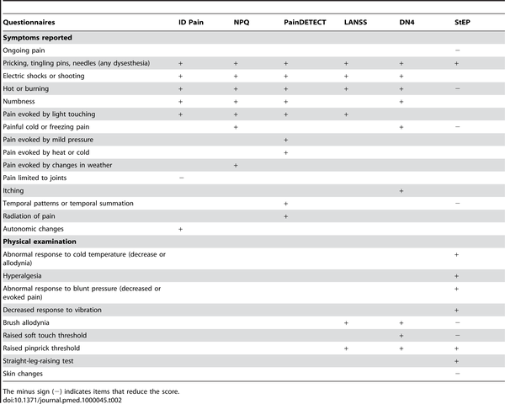

Slide 12
Neurologic Examination
Motor system evaluation
Somatosensory assessment
Autonomic nervous system exam

Slide 13
Pharmacologic Treatment of NP
Several general considerations and limitations regarding pharmacological treatment recommendations for NP.
Most RCTs have examined patients with either PHN or painful DPN
RCTs differ substantially in research design and outcomes reported
Finally, treatment duration in RCTs of medications for NP has been relatively short, typically 3 months or less, which is in marked contrast to the chronic nature of most NP conditions
lack of direct comparisons of different medications makes it difficult to contrast and rank medications on the basis of efficacy, safety, and tolerability

Slide 14
GUIDELINES FOR THE PHARMACOLOGICAL MANAGEMENT OF NP
(Robert et al. Mayo Clin Proc. 2010; 85(3_suppl): S3-S14.
The NeuPSIG guidelines recommend medications as:
first-line treatment if efficacy in NP has been established in multiple RCTs
second-line if efficacy in NP has been established in multiple RCTs (grade A recommendation), but there were reservations about their use
third-line if only one RCT has shown efficacy in NP or if the results of 2 or more RCTs were inconsistent

Slide 15
  These consensus guidelines were not intended to apply:
    to pediatric patients,
    patients with trigeminal neuralgia
    or conditions that are not clearly NP (eg, fibromyalgia and irritable bowel syndrome).

Slide 16
Stepwise Pharmacological Management of Neuropathic Pain
Step 1
  Assess pain & establish diagnosis of NP
  Establish & treat the cause of NP
  Identify relevant comorbididies that may affect or be affected by NP treatment
  Explain the diagnosis & tratment plan to the patient & establish realistic expectations

Slide 17
Step 2
  Initiate treatment of the cause of NP
  Initiatite treatment with 1 or more of:
    2ry amine TCAs (nortriptyline or desipramine) or SSNRIs (Duloxetine or Venlafaxine)
    Calcium Channel α₂-δ Ligands (Gabapentin and Pregabalin)
  For localized peripheral PN, lidocaine alone or with 1st line drugs
  For acute NP, cancer NP, or severe episodic excacerbation of pain, use opioids or tramadol alone or with 1st line drugs

Slide 18
Step 3
  Reassess pain & QOL frequently
  With marked pain relief & tolerable side effects Continue treatment
  With partial pain relief after adequate trial Add another 1st- line medication
  With inadequate pain relief after adequate trial Switch to another 1st- line medication
  With inadequate pain relief after adequate trial with 1st-line medication Switch to 2nd or 3rd-line medications

Slide 19
First-line Medications
Secondary- amine TCAs or SSNRIs
Calcium Channel α₂-δ Ligands

Slide 20
TCAs
Advantages
efficacious for several different types of NP
TCAs are efficacious for the treatment of depression
inexpensive
administered once daily

Slide 21
Disadvantages
Anticholinergic adverse effects are common and include dry mouth, orthostatic hypotension, constipation, and urinary retention.
((can be reduced by starting with low dosages administered at bedtime and with slow titration to higher dosages and also by using a secondary amine TCA (nortriptyline or desipramine))
Cardiac toxicity is a concern, used with caution in patients with ischemic cardiac disease or ventricular conduction abnormalities
limiting the dosages to less than 100 mg/d when possible, and obtaining a screening electrocardiogram for patients older than 40 years.

Slide 22
Dosage of 2ry-amine TCA
Start at 25mg at bed time and increase by 25mg every 3-7 days to a maximum 100mg/day
It can take 6 to 8 weeks, including 2 weeks at the highest dosage tolerated, for an adequate trial of treatment with a TCA

Slide 23
SSNRIs
Duloxetine (cymbalta 30,60 mg cap)
effectivein painful DPN, but not been studied in other types of NP
Effective in the treatment of major depression and generalized anxiety disorder
its dosing is simple, with 60 mg once daily
most common adverse effect is nausea, can be reduced by administering 30 mg once daily for one week before increasing to 60 mg once daily
It can take 4weeks, for an adequate trial of treatment with Duloxetine

Slide 24
SSNRIs
Venlafaxine (efexor 37.5, 75mg tab)
has shown efficacy in painful DPN and painful polyneuropathies of different origins but not in PHN
Start at 37.5mg once or twice daily and increase by 75mg every week to a maximum 225mg/day
It can take 4-6 weeks, for an adequate trial of treatment
should be tapered when treatment is being discontinued because a withdrawal syndrome has been described.

Slide 25
Venlafaxine
Expensive (100-250 Eg. pounds per month)
Cardiac conduction abnormalities
blood pressure increases
(should be prescribed with caution in those with cardiac disease)
Insomnia, nervousness, vived dreams
(used with caution in those with history of seizures)

Slide 26
Calcium Channel α₂-δ Ligands
(Gabapentin and Pregabalin)
efficacy vs placebo in several NP conditions
both can produce dose-dependent dizziness and sedation, which can be reduced by starting with lower dosages and titrating cautiously
both medications also require dosage reduction in patients with renal insufficiency,.

Slide 27
Gabapentin
Pharmacokinetics are nonlinear (due to saturable absorption),
Start at 100-300mg at bed time or thrice daily and increase by 100-300mg every 1-7 days, as tolerated, until pain relief, dose-limiting adverse effects, or 3600 mg/d in 3 divided doses is reached
It can take 6 to 8 weeks, including 2 weeks at the highest dosage tolerated, for an adequate trial

Slide 28
Pregabalin
The efficacy and tolerability similar to those of gabapentin;
pregabalin has linear pharmacokinetics, and dosing is more straightforward.
Most patients can start taking the drug at 150 mg/d in 2 or 3 divided doses, which is then titrated up to 300 mg/d after 1 or 2 weeks
( higher dosages are not consistently more effective than 300 mg/d and are associated with a greater rate of adverse effects.)

Slide 29
Topical Lidocaine(5% patch or gel)
Effective in PHN and in patients with allodynia due to different types of peripheral NP

Slide 30
Second-line Medications (Opioids)
Tramadol and opioid analgesics have shown efficacy in several high-quality RCTs involving patients with different types of NP
Why are opioids not recommended for first-line use???
because of concerns regarding long-term safety, including risks of , immunologic changes, and opioid misuse or abuse

Slide 31
Opioids
Recommended as first-line treatments for:
  acute NP,
  NP due to cancer,
  pisodic exacerbations of severe NP,
  when titrating one of the first-line medications if prompt relief of pain is required.

Slide 32
Third-line Medications
Be reserved for patients who cannot tolerate or who do not respond adequately to first- and second-line medications.
These medications include:
  certain antidepressants (eg, bupropion, citalopram, and paroxetine),
  certain antiepileptics (eg, carbamazepine, lamotrigine, oxcarbazepine, topiramate, and valproic acid),
  topical low-concentration capsaicin,
  dextromethorphan,
  memantine, and
  mexiletine.

Slide 33
Combination Therapies
No one medication is universally effective.
Hence, in clinical practice, 2 or more medications are often used in combination to possibly achieve either an additive beneficial effect or a reduction in the adverse effects associated with the use of a single medication.

Slide 34
Gabapentin and extended-release morphine titrated together required lower dosages of both medications and resulted in better pain relief than when either medication was administered alone in patients with PHN or painful DPN*
Extended-release oxycodone and pregabalin showed improved pain relief at lower dosages**
Nortriptyline and gabapentin superior to either of these 2 medications administered alone***
* Gilron et al. N Engl J Med. 2005;352(13):1324-1334.
** Gatti et al. Eur Neurol. 2009;61(3):129-137
***Gilron et al. Lancet 2009;374(9697):1252-1261.

Slide 35
Potential medications for NP in future
Botulinum Toxin
High-Concentration Capsaicin Patch
Lacosamide ( new antiepileptic acting at voltage-gated sodium channels)

Slide 36
Refractory forms of Peripheral PN
Painful HIV neuropathy
Chemotherapy-induced peripheral neuropathy
Lumbosacral radiculopathy

Slide 37
Central NP
Seems to be relatively more refractory to treatment than peripheral NP.
Efficacy has been shown for:
  TCAs in central poststroke NP,
  Calcium channel α₂-δ ligands in spinal cord injury and central poststroke NP,
  Tramadol in spinal cord injury NP

Slide 38
Herpes Zoster (Shingles) and Postherpetic Neuralgia
Sampathkumar et al. Mayo Clin Proc. 2009 ; 84(3): 274–280
HZ, commonly called shingles from the Latin cingulum, meaning belt
HZ is a distinctive syndrome caused by reactivation of varicella zoster virus (VZV).
The risk of HZ increases with age; approximately half of all cases occur in persons older than 60 years.
Postherpetic neuralgia (PHN) is defined as pain persisting more than 3 months after the rash has healed.

Slide 39
DIAGNOSIS of HZ
Prodromal symptoms that herald HZ include pruritus, dysesthesia, and pain along the distribution of the involved dermatome.
The classic skin findings are grouped vesicles on a red base in a unilateral, dermatomal distribution
Detection of viral DNA by polymerase chain reaction

Slide 40


Slide 41
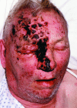

Slide 42
TREATMENT OF ACUTE HZ
1. Antivirals
  Famciclovir 250mg orally 3 times daily for 7 days
  Valacyclovir 1g orally 3 times daily for 7 days
  Acyclovir, 800mg orally 5 times daily for 7 days
Antiviral treatment is specifically recommended for:
  patients older than 50 years,
  those who have moderate or severe pain or rash, and
  those with involvement of nontruncal dermatomes (eg, the face).

Slide 43
2. Corticosteroids
Prednisolone 60mg/day orally for 7 days and then taper the dose in the next week
used only in patients with severe symptoms at presentation or in whom no major contraindications to corticosteroids exist.
In combination with antiviral therapy, they modestly reduce the severity and duration of acute symptoms & do not have any effect on PHN

Slide 44
3. Analgesics
NSAIDs are usually ineffective,
Opioids may be required.

Slide 45
PHN
The risk of PHN after HZ increases with age*
  5% in those younger than 60 years
  10% in those aged 60 to 69 years
  20% in those aged 80 years or older.
PHN presents as intermittent pain, allodynia, insomnia, depression
Treatment: Lidocaine patch + Antidepressant + pregabalin or gabapentin
*Yawn et al. Mayo Clin Proc. 2007;82(11):1341-1349

Slide 46
PREVENTION of HZ & PHN
In 2006,Zostavax ( a live, attenuated vaccine) to prevent HZ received approval by the FDA
In 38,000 healthy adults older than 60 years, the vaccine reduced the incidence of HZ by 51%, the burden of illness from HZ by 61%, and the risk of PHN by 66%*
recommended routinely for all adults 60 years and older with 1 dose of HZ vaccine, whether or not they have a history of HZ
Antivirals active against VZV (acyclovir, famciclovir, and valacyclovir) should not be taken 24 hours before and 14 days after receiving vaccine
The vaccine is relatively expensive, costing approximately $160
The VZV vaccine is contraindicated in the setting of severe immunosuppression because it is a live vaccine
* Oxman et al. N Engl J Med. 2005;352(22):2271-2284

Slide 47
Thank You

